Slide 1


Crowdfunding is in Fashion
Liz Gee
Programme Director, Fashion Management | Fashion Business School
1
of 20

Slide 2


Branded crowdfunding for Universities
A safe place to test ideas
Henry Jinman
Founder and CEO, Crowdfund Campus
henry@crowdfundcampus.com
07545898120
1
of 20

Slide 3

of 20

Slide 4

Students Loved it!
of 20

Slide 5
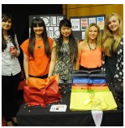
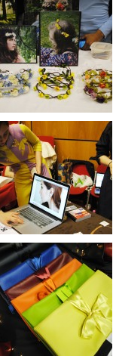
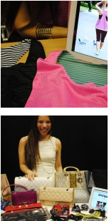
of 20

Slide 6
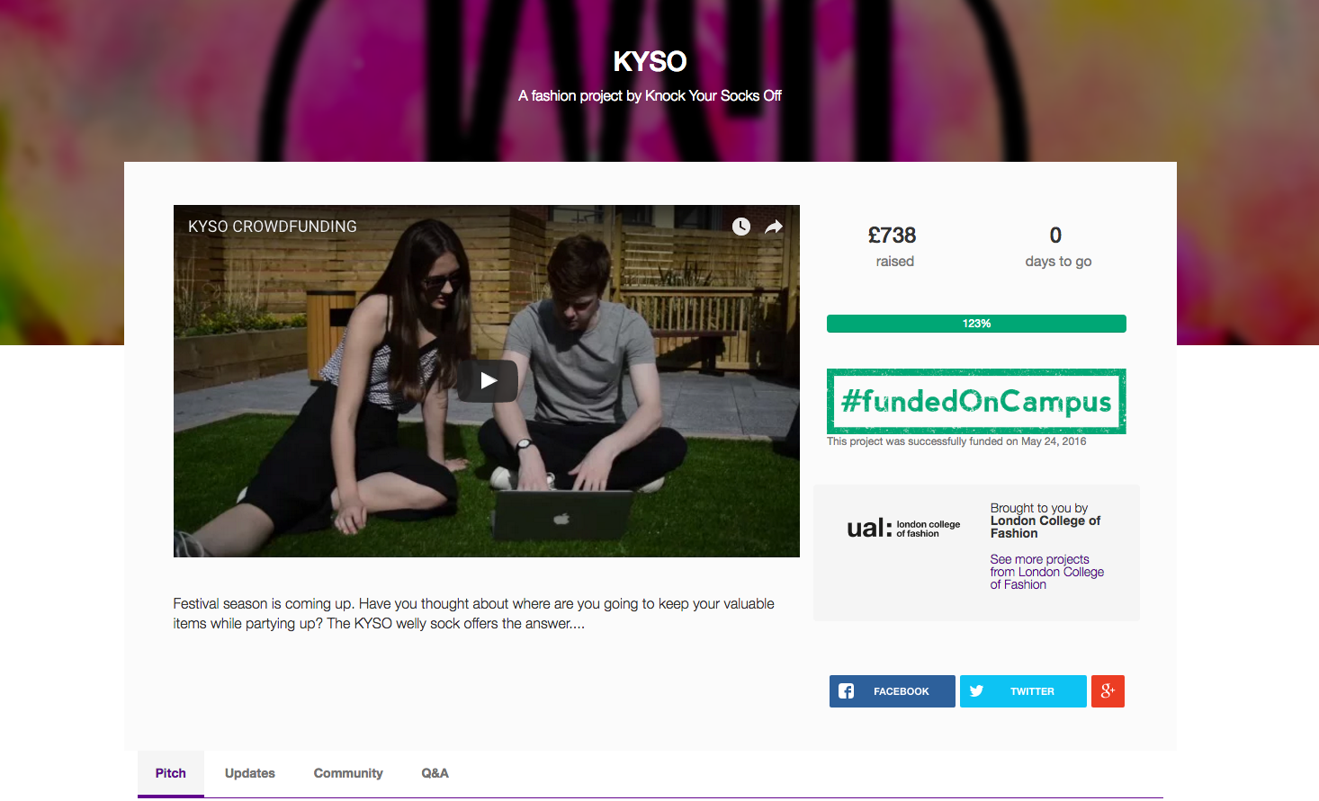
of 20

Slide 7
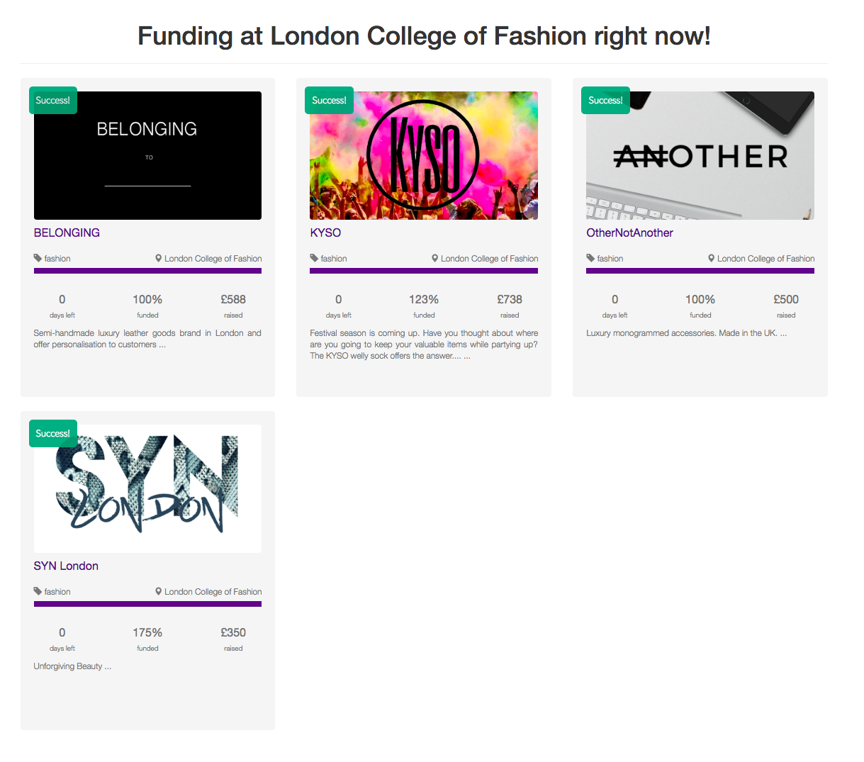
of 20

Slide 8
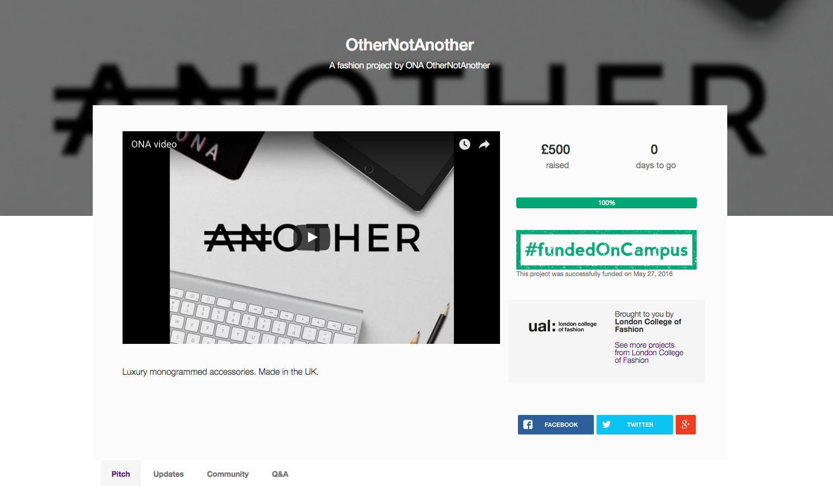
of 20

Slide 9
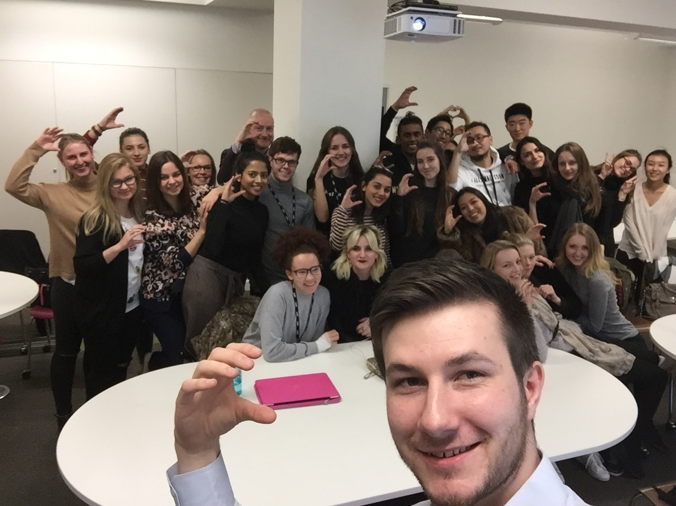
Student selfie after crowdfunding workshop!
of 20

Slide 10
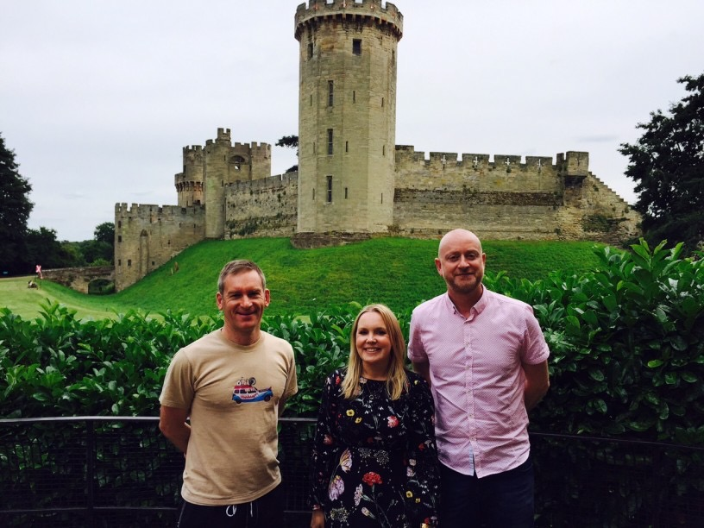
Some of the educators at Warwick Castle
of 20

Slide 11
Students rated CC as an educational tool!
of 20

Slide 12
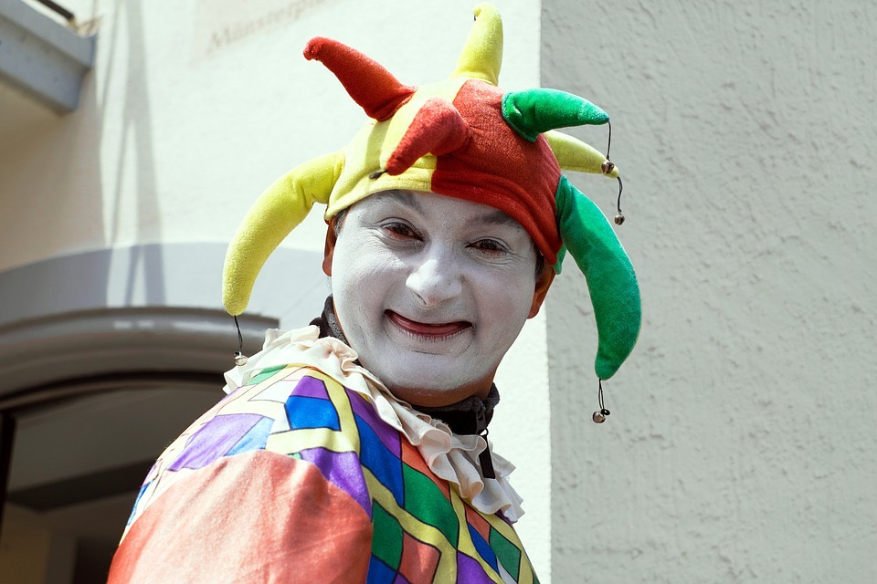
Friends, family, fools and customers!
of 20

Slide 13

Our Comments on the Campaigns
of 20

Slide 14

Our Learning
of 20

Slide 15

Feedback from the delivery team
of 20

Slide 16

of 20

Slide 17

BUSINESS PLAN
of 20

Slide 18
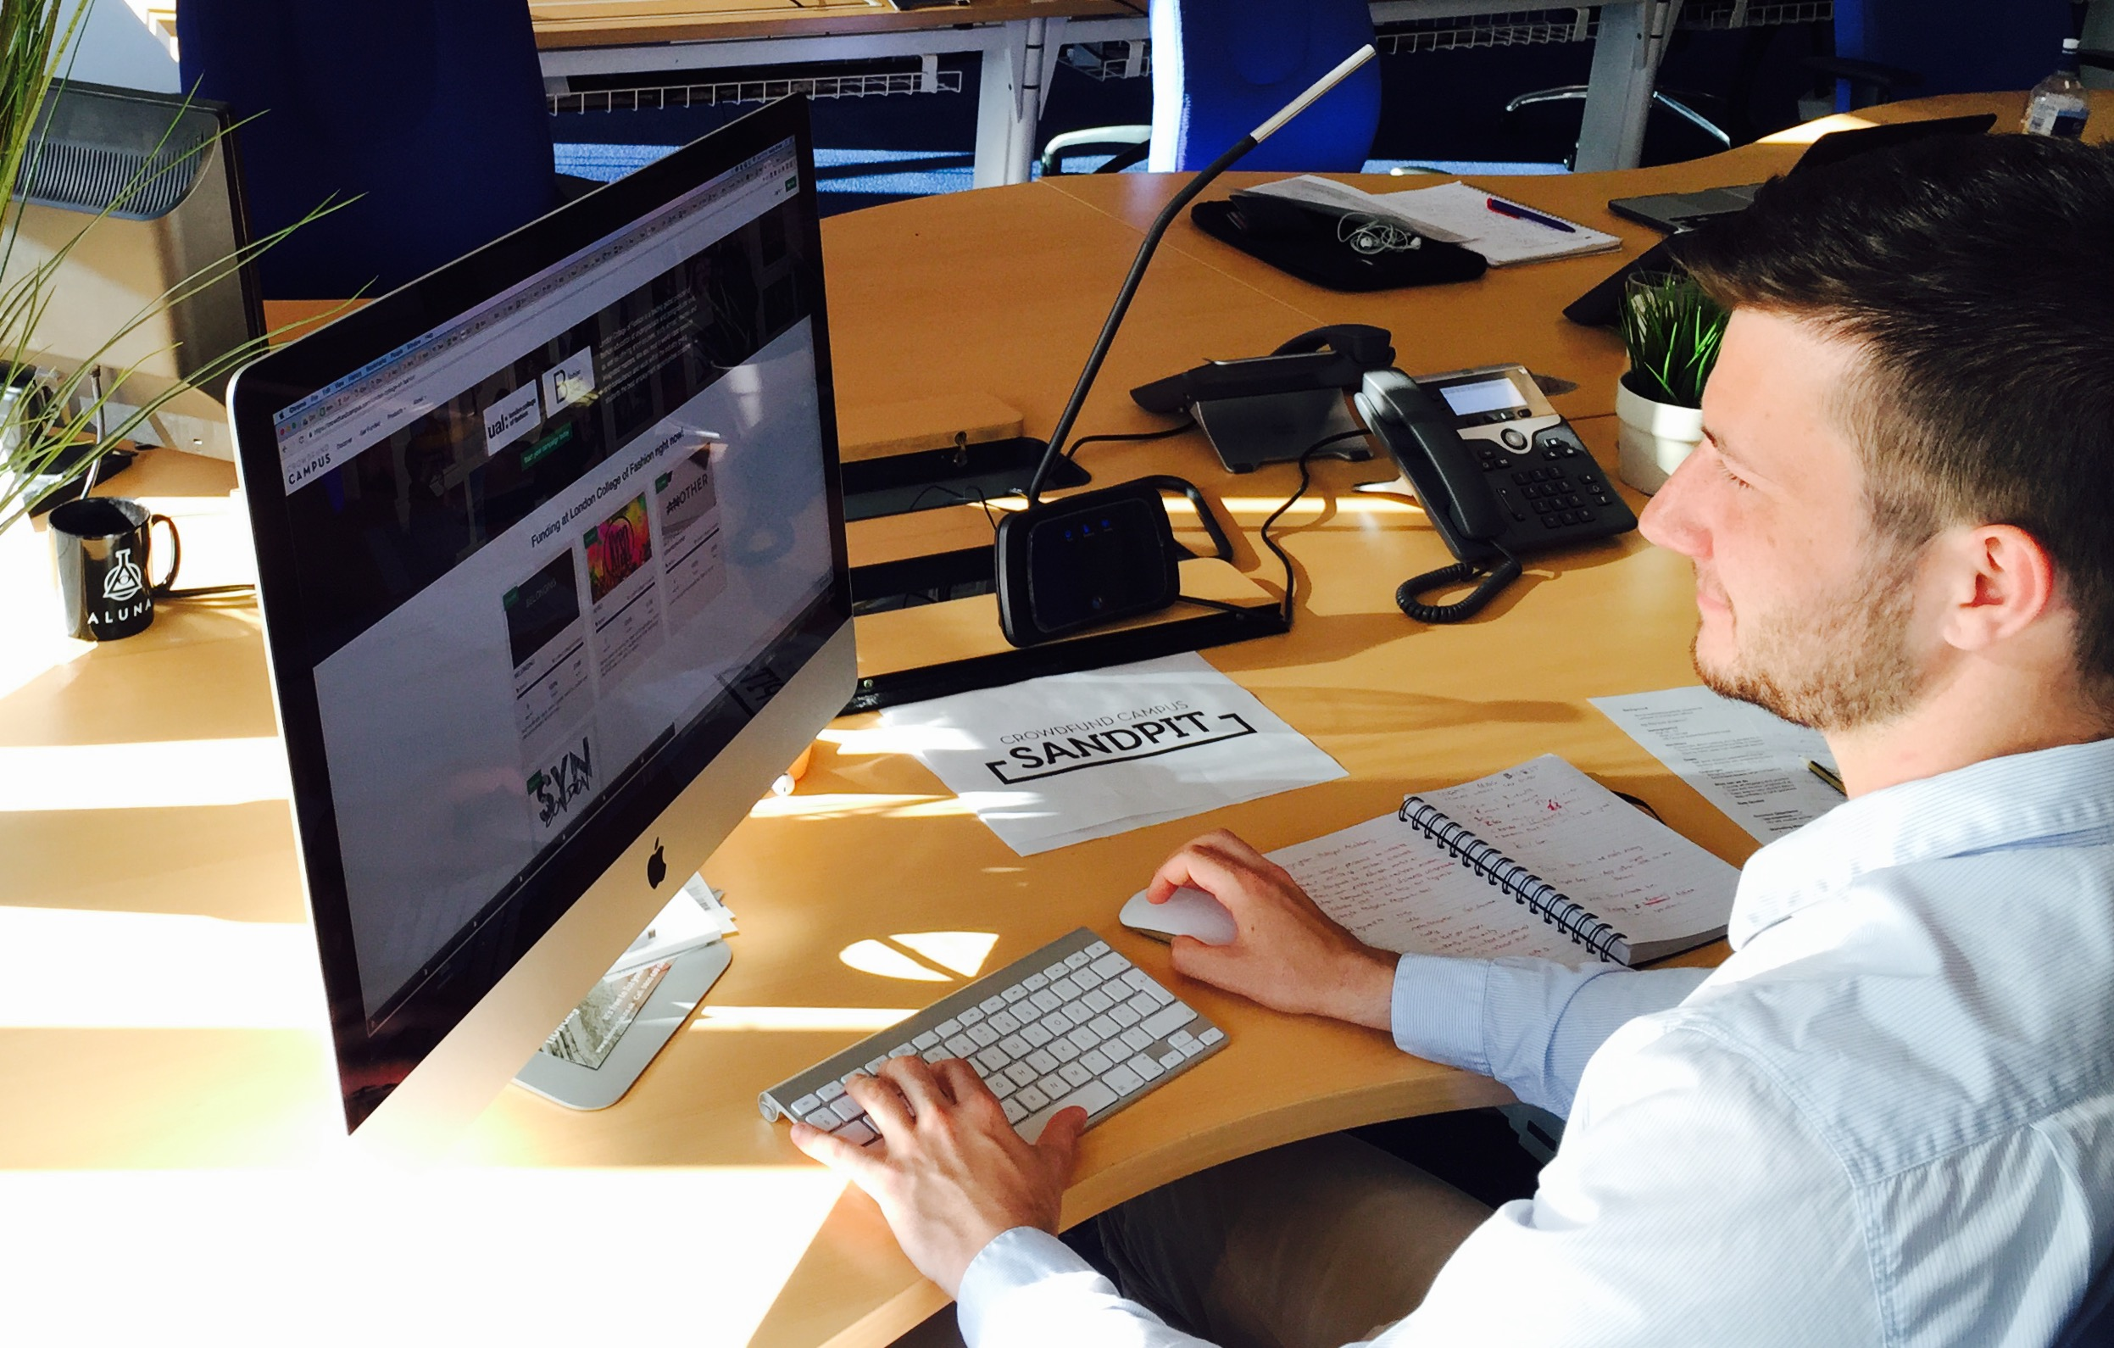
Always looking for improvements.
of 20

Slide 19
A safe place to test ideas
of 20

Slide 20

of 20

