Slide 1
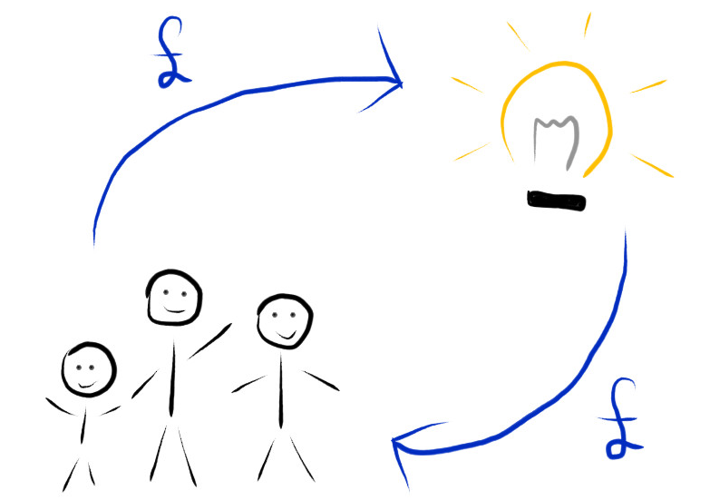
1
of 20

Slide 2
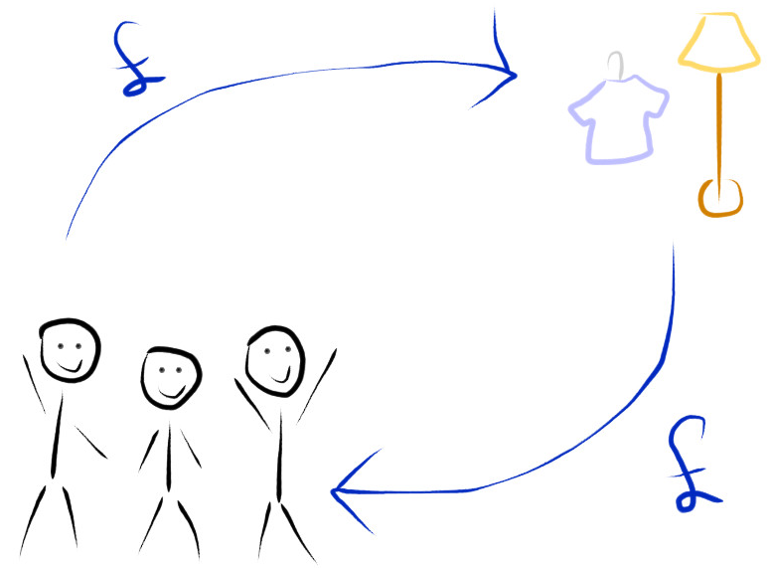
2
of 20

Slide 3

3
of 20

Slide 4
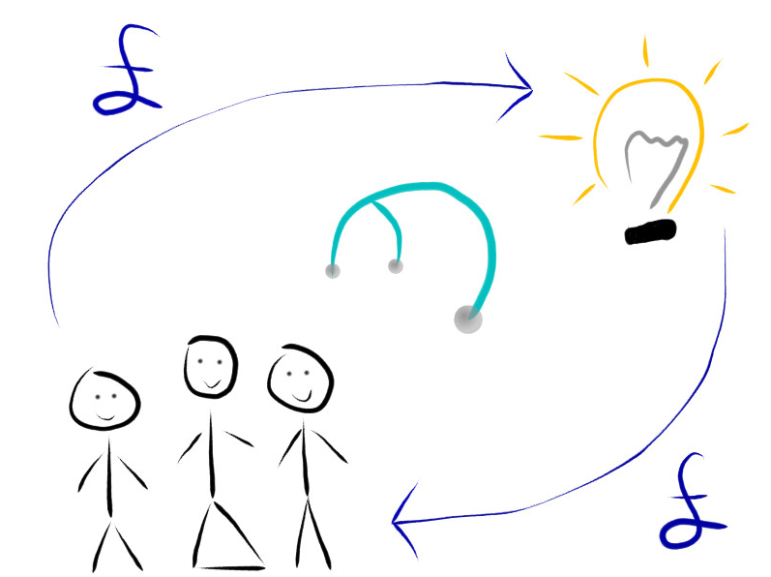
4
of 20

Slide 5

5
of 20

Slide 6

6
of 20

Slide 7

7
of 20

Slide 8

8
of 20

Slide 9

9
of 20

Slide 10
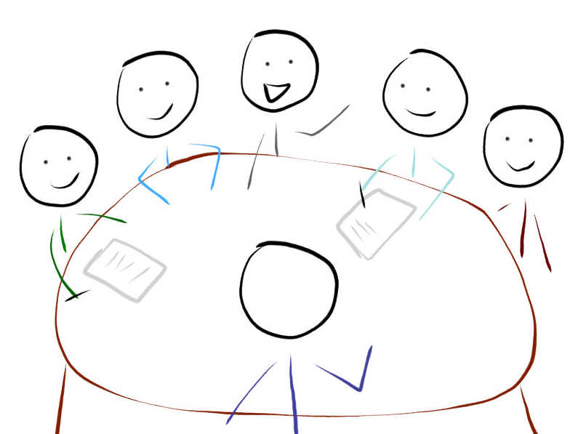
10
of 20

Slide 11

11
of 20

Slide 12
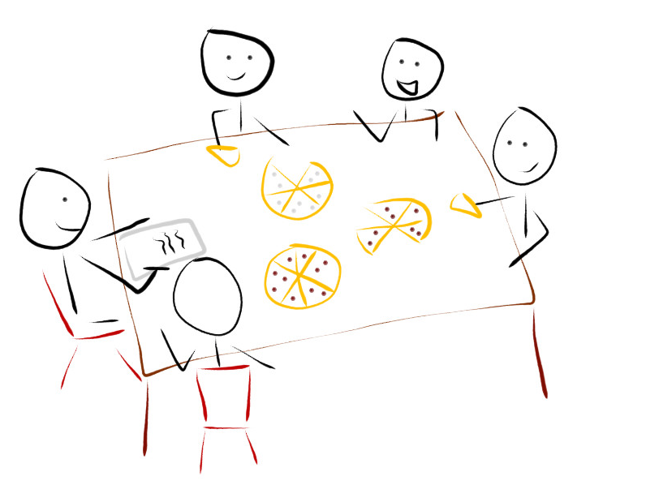
12
of 20

Slide 13
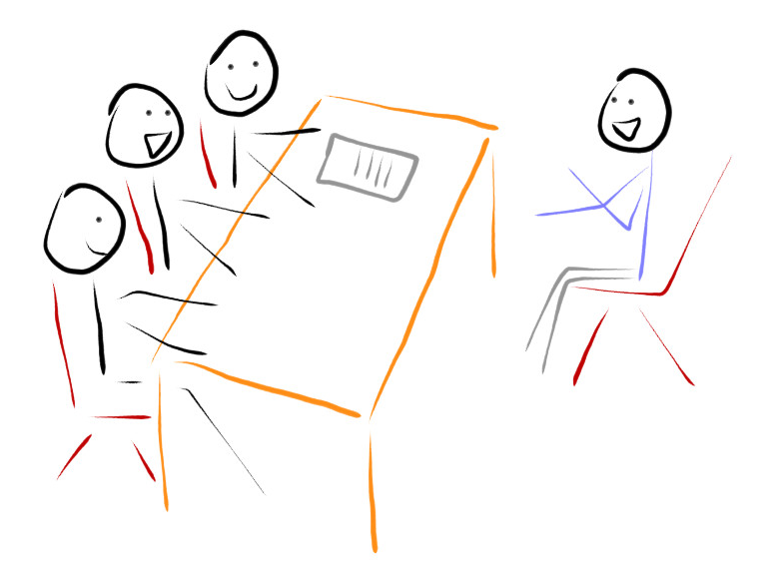
13
of 20

Slide 14
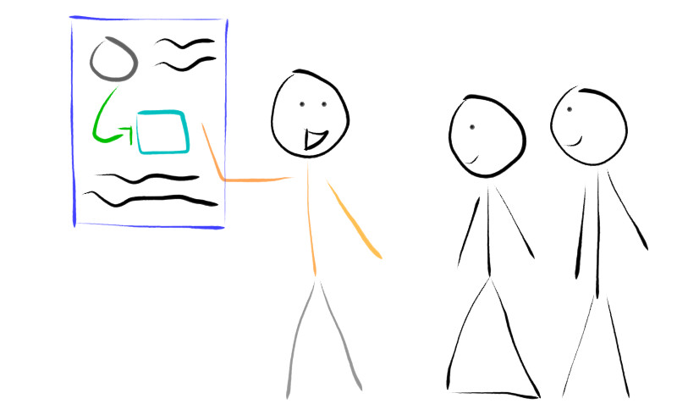
14
of 20

Slide 15
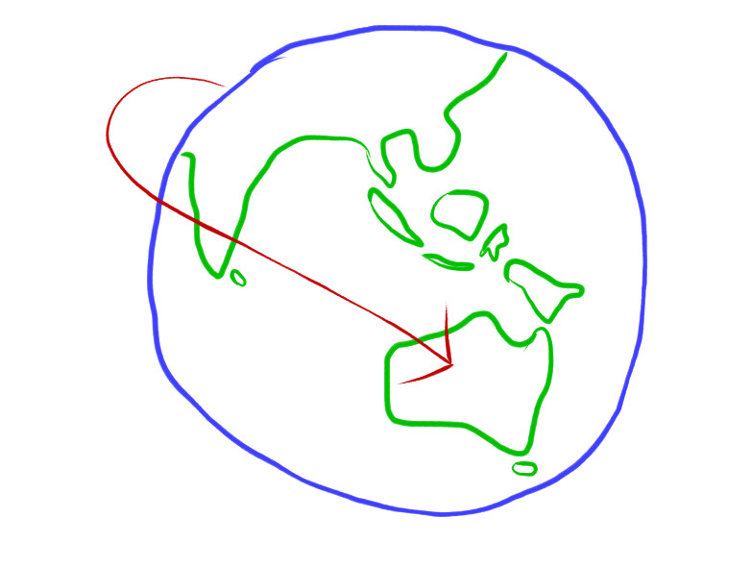
15
of 20

Slide 16
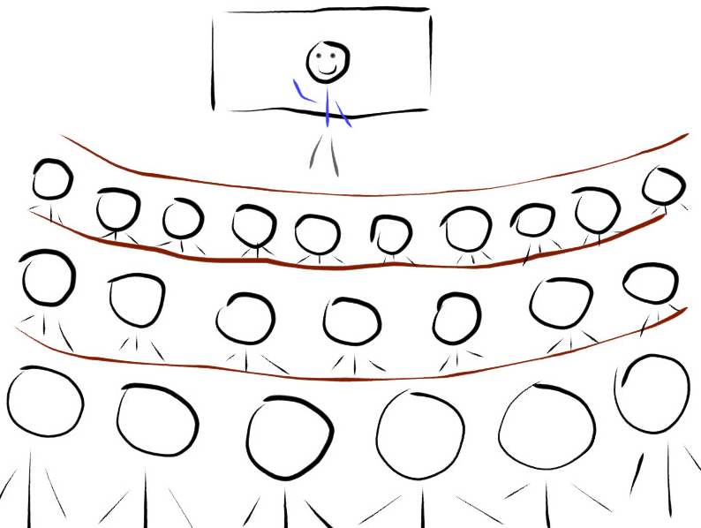
16
of 20

Slide 17
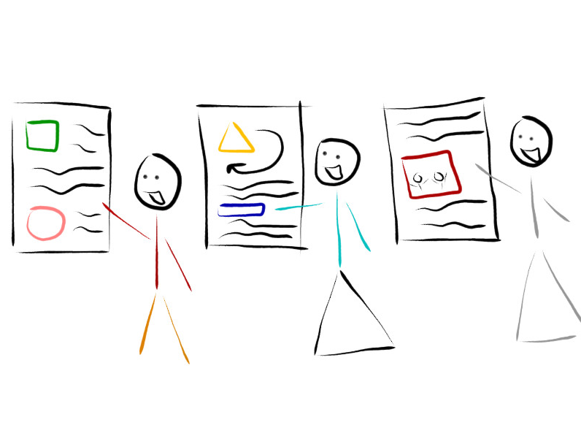
17
of 20

Slide 18
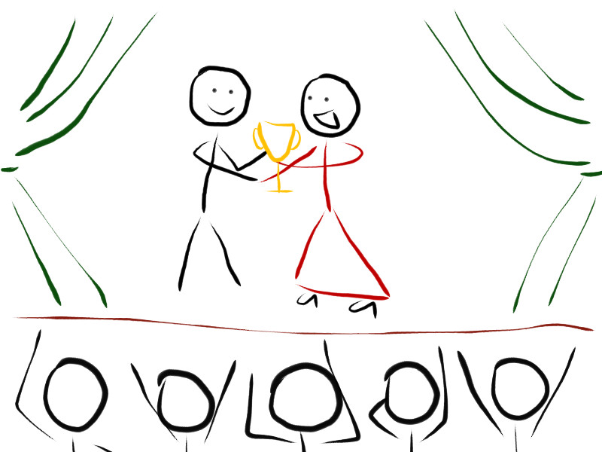
18
of 20

Slide 19

19
of 20

Slide 20

20
of 20

